Slide 1
DEEP LEarNiNg MastEr Class
Day-17

Slide 2
01
Object recognition using Pre trained model
Concept

Slide 3
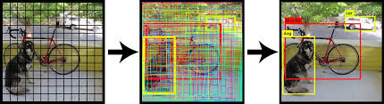
Object Recognition.
Object recognition is a computer vision technique for identifying objects in images or videos. Object recognition is a key output of deep learning and machine learning algorithms. When humans look at a photograph or watch a video, we can readily spot people, objects, scenes, and visual details.

Slide 4
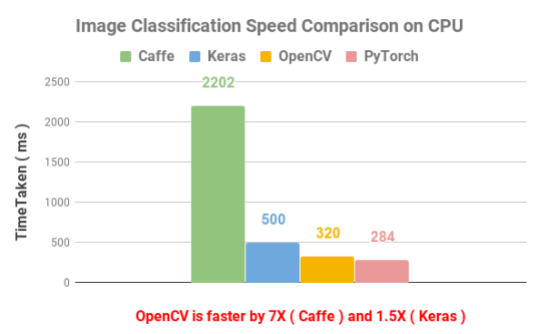
Speed Comparison on Image Classification.

Slide 5
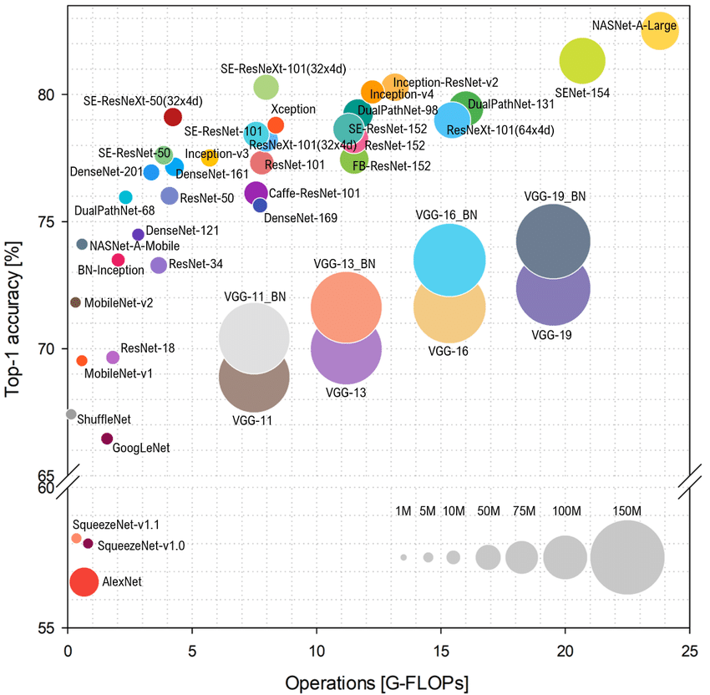
Pre-trained Model for Object recognition.
MobileNet-SSD
GoogleNet
Squeezenet
Faster R-CNN
ResNet
Inception
YOLO
VGGNet

Slide 6
MobileNet SSD (Single shot Multibox Detector).
The MobileNet model is based on depthwise separable convolutions which are a form of factorized convolutions. These factorize a standard convolution into a depthwise convolution and a 1 × 1 convolution called a pointwise convolution.
For MobileNets, the depthwise convolution applies a single filter to each input channel. The pointwise convolution then applies a 1 × 1 convolution to combine the outputs of the depthwise convolution.
A standard convolution both filters and combines inputs into a new set of outputs in one step. The depthwise separable convolution splits this into two layers – a separate layer for filtering and a separate layer for combining. This factorization has the effect of drastically reducing computation and model size.
The SSD architecture is a single convolution network that learns to predict bounding box locations and classify these locations in one pass. Hence, SSD can be trained end-to-end.

Slide 7
OpenCV Basic Syntax for DNN.
Loading Image from Disk to DNN
cv2.dnn.blobFromImage
cv2.dnn.blobFromImages
Import Model from various Framework
cv2.dnn.createCaffeImporter
cv2.dnn.createTensorFlowImporter
cv2.dnn.createTorchImporter
cv2.dnn.readNetFromCaffe
cv2.dnn.readNetFromTensorFlow
cv2.dnn.readNetFromTorch
cv2.dnn.readhTorchBlob
.forward` method is used to forward-propagate our image and obtain the actual classification.

Slide 8
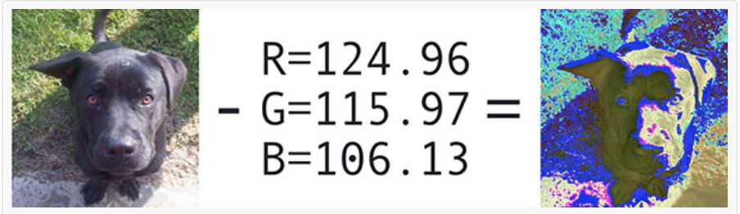
Pre-trained Model for Object recognition.
Mean Subtracted Normalized Image = cv2.dnn.blobFromImage(resizedImage,scalingFactor, Spatial Size, Mean Subtraction Values)
blob = cv2.dnn.blobFromImage(imResizeBlob,0.007843, (300, 300), 127.5)

Slide 9
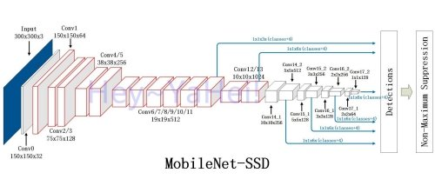
MobileNet SSD Architecture.

Slide 10
Block Diagram – Workflow of DNN in OpenCV.
Load Model
Select Backend
Select target
Reading frame from camera
Convert to Blob
Forward
Post Process

Slide 11
Deep Learning Terminology - 1
Do you think Deep Learning is Better than Machine Learning? If so, why?
Though traditional ML algorithms solve a lot of our cases, they are not useful while working with high dimensional data, that is where we have a large number of inputs and outputs.

Slide 12
Deep Learning Terminology - 2
Steps for using a gradient descent algorithm?
Initialize random weight and bias.
Pass an input through the network and get values from the output layer.
Calculate the error between the actual value and the predicted value.
Go to each neuron which contributes to the error and then change its respective values to reduce the error.
Reiterate until you find the best weights of the network.

Slide 13
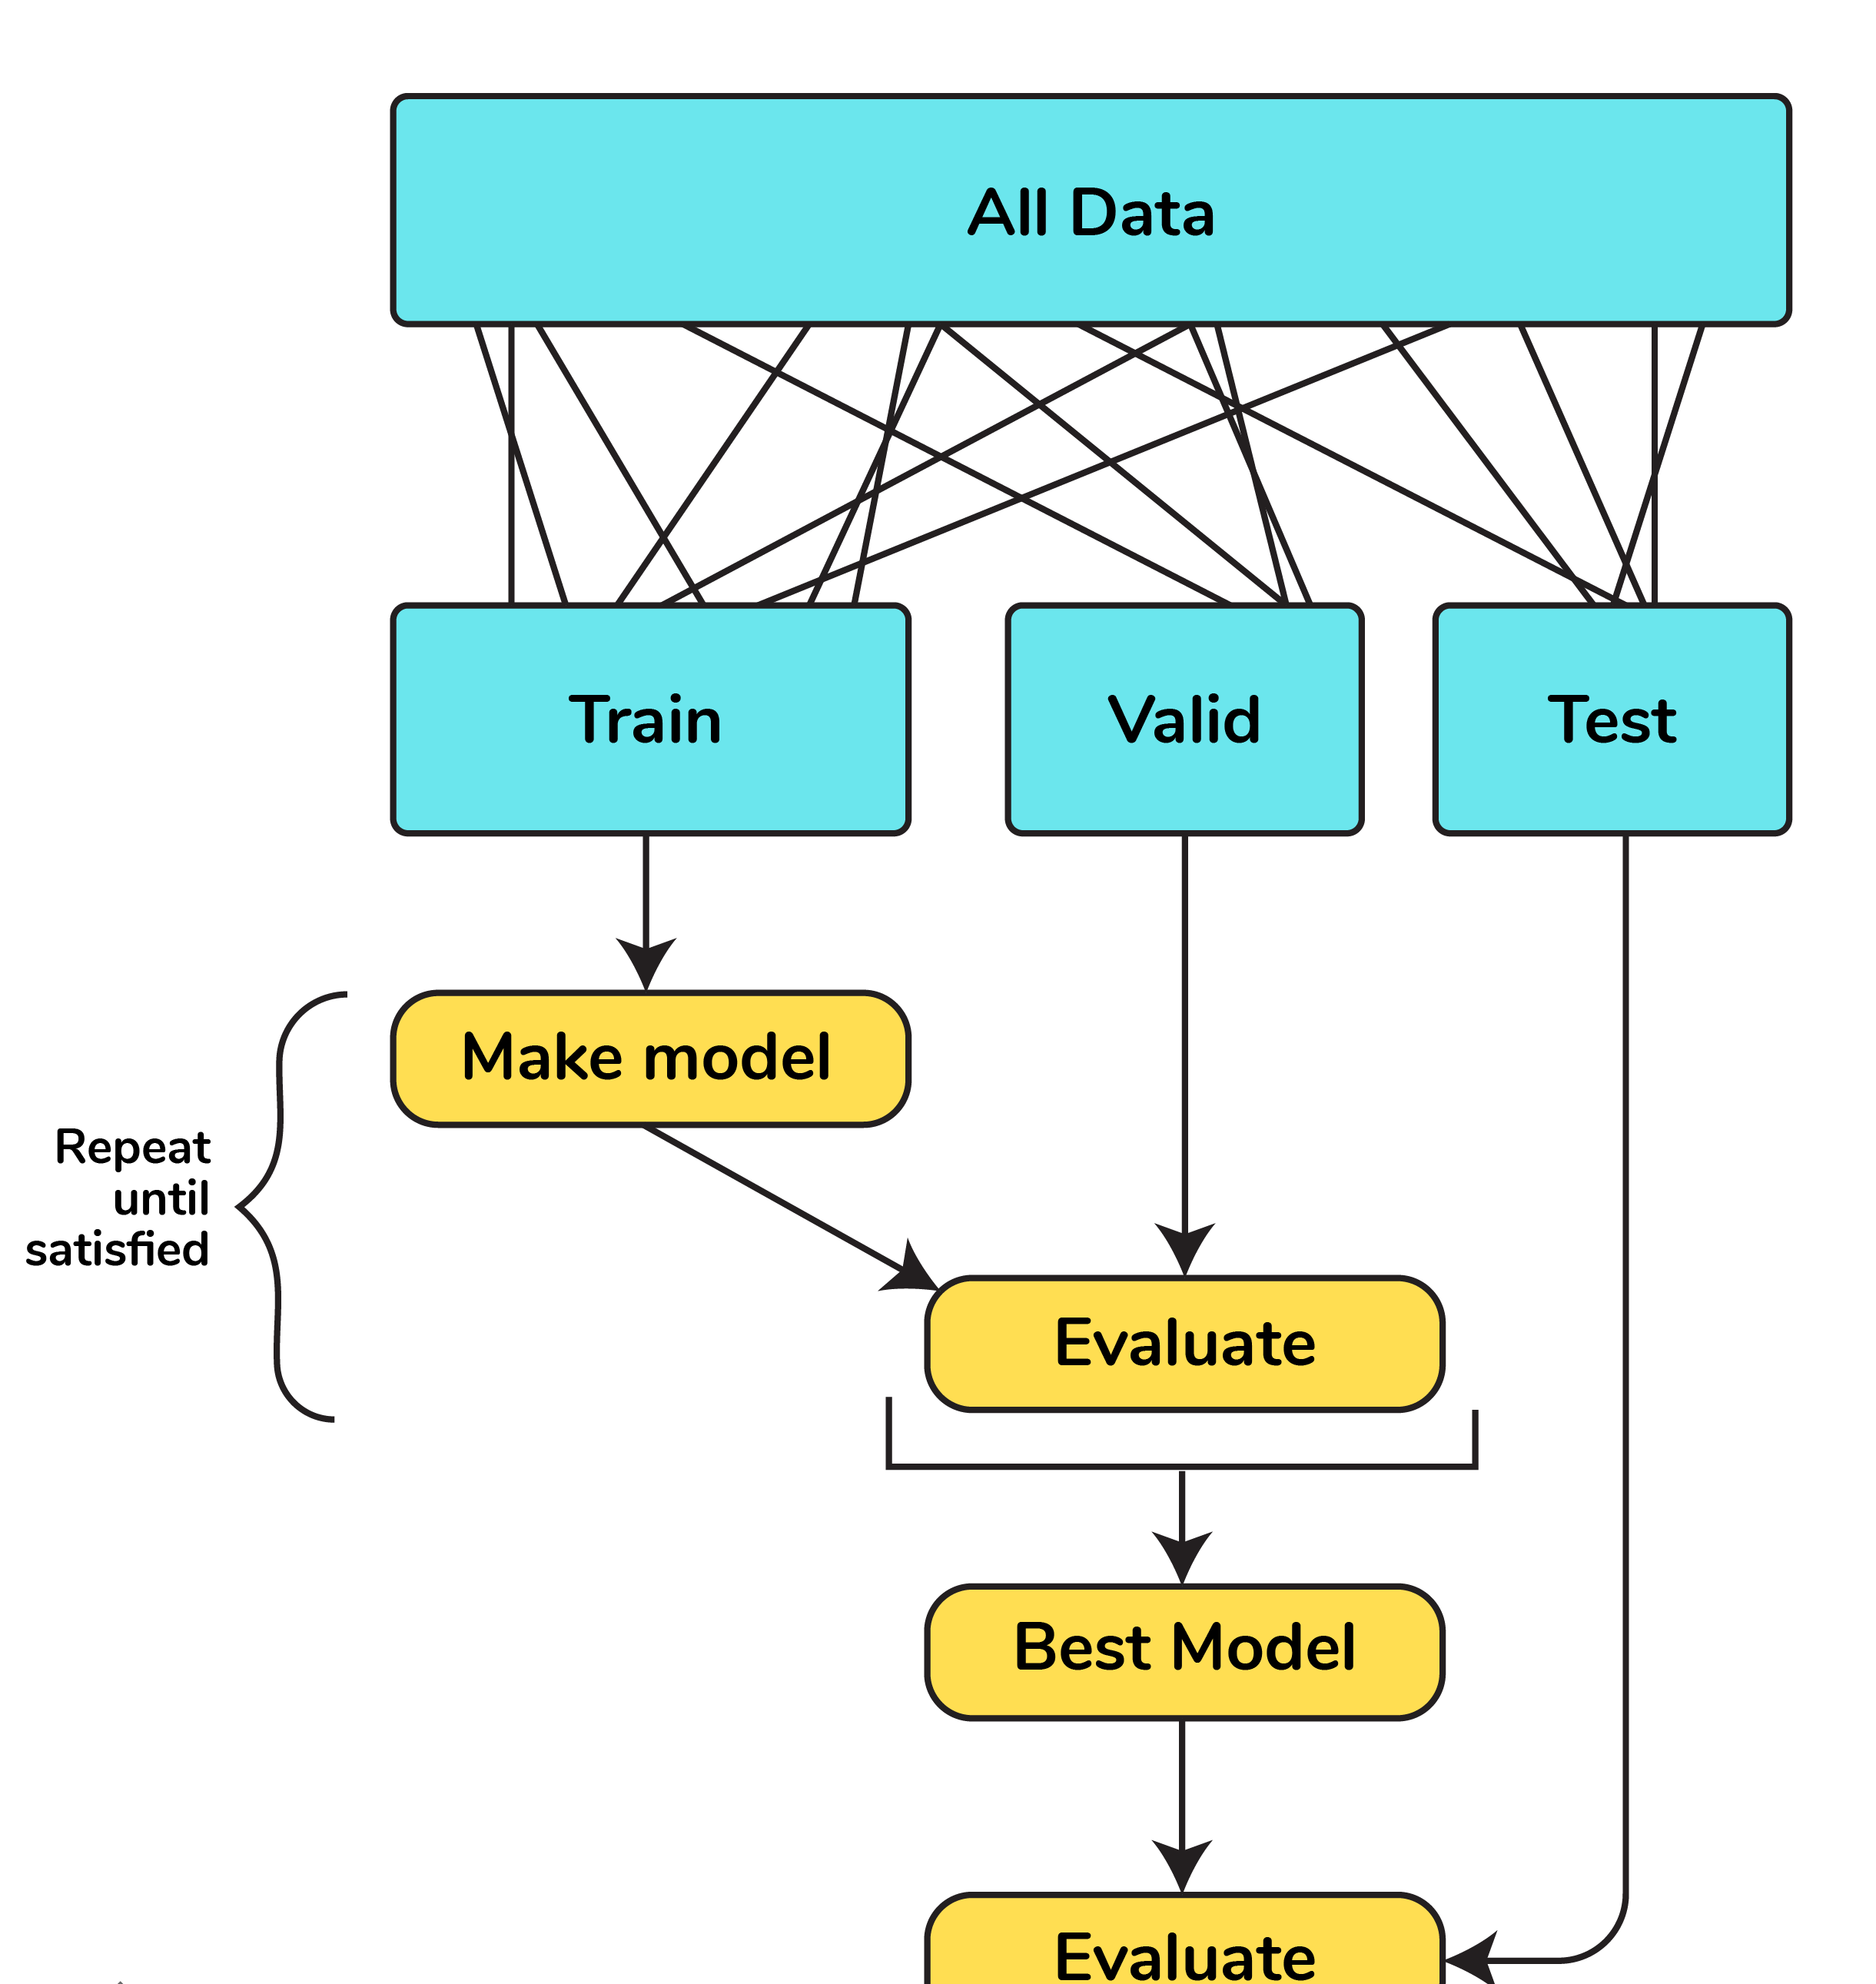
Deep Learning Terminology - 3
Cross-Validation
Cross-validation is a method of splitting all your data into three parts: training, testing, and validation data. Data is split into k subsets, and the model has trained on k-1of those datasets.
The last subset is held for testing. This is done for each of the subsets. This is k-fold cross-validation. Finally, the scores from all the k-folds are averaged to produce the final score.

Slide 14
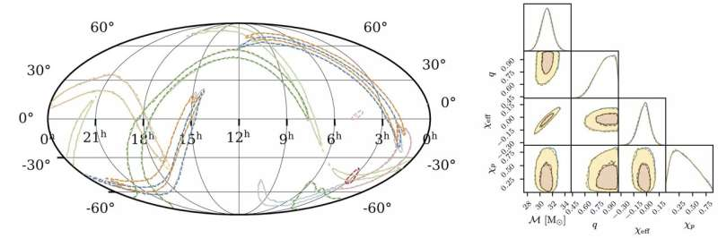
A.I News
Short bytes – D17
Neural network analyzes gravitational waves in real time
Black hole with the mass of our sun has a radius of only 3 kilometers. Black holes in orbit around each other emit gravitational radiation—oscillations of space and time predicted by Albert Einstein in 1916. This causes the orbit to become faster and tighter, and eventually, the black holes merge in a final burst of radiation. These gravitational waves propagate through the universe at the speed of light, and are detected by observatories in the U.S. (LIGO) and Italy (Virgo). Scientists compare the data collected by the observatories against theoretical predictions to estimate the properties of the source, including how large the black holes are and how fast they are spinning. Currently, this procedure takes at least hours, often months.
They developed an algorithm using a deep neural network, a complex computer code built from a sequence of simpler operations, inspired by the human brain. Within seconds, the system infers all properties of the binary black-hole source.

Slide 15
Thanks!
Thanks!
Follow Me on LinkedIn : Link in Description
+91 7305845758
Pantechsolutions.net
Ask Your Friends to Participate on this Event

